Slide 1




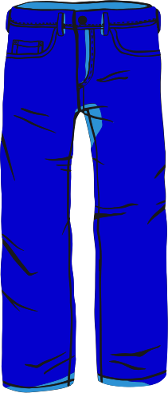
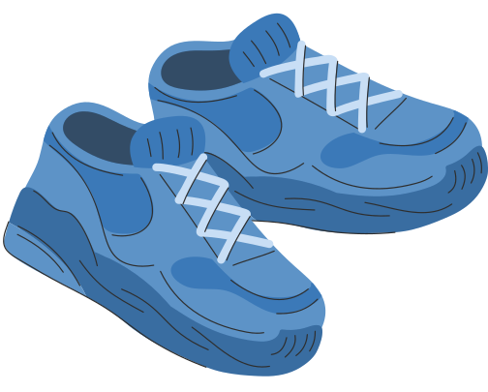
Machine Learning Project
FASHION MINST
JOSHUA GORDON & AMIT TUBUL

Slide 2


Machine Learning Project
TABLE OF CONTENT
INTRODUCTION
DATASET
OUR MODELS
PROBELMS
SOLUTIONS
CONCLUSION

Slide 3
FASHION MINST
INTRODUCTION
DATASET INFOMATION
THE FASHION MNIST DATASET CONSISTS OF 70,000 28X28 GRAYSCALE IMAGES IN 10 DIFFERENT CLASSES, WITH 7,000 IMAGES PER CLASS. THERE ARE 60,000 TRAINING IMAGES AND 10,000 TEST IMAGES.
The labels our models will be predicting are the classes, hence we are dealing with a multiclass classification problem.
We shall split the dataset for training and testing with the current structure of the dataset, meaning 80/20 train test split. (As there are 60,000 train images and 10,000 test images).
WE WILL BE KEEPING IN MINID THE FOLLOWING QESTIONS:
A) WHAT IS THE DISTRIBUTION OF THE 10 CLASSES IN THE DATASET?
B) HOW DO SIMPLE MODELS PERFORM ON THIS DATASET?
C) CAN MORE COMPLEX MODELS IMPROVE THE CLASSIFICATION ACCURACY?
D) WHAT ARE THE TRADE-OFFS BETWEEN DIFFERENT MODELS?
E) WHAT ARE THE MOST COMMON MISCLASSIFICATIONS MADE BY THE MODELS?

Slide 4
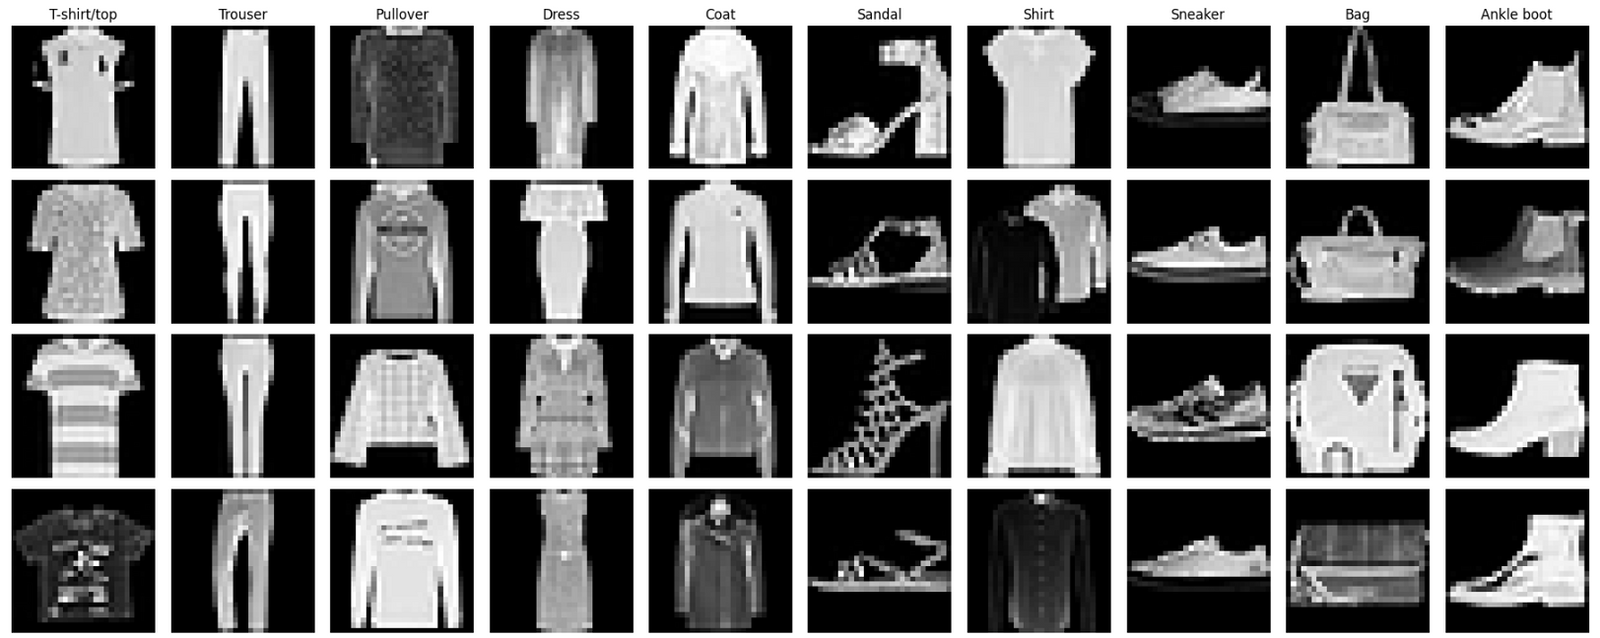
FASHION MINST
INTRODUCTION
DATASET SAMPLE
BELOW WE CAN SEE A SAMPLE OF THE DATASET. AS MENTIONED EACH IMAGE IS A GREY SCALE IMAGE OF THE SIZE (28,28). THE FOLLWING CLASSES ARE: T-SHIRT, TROUSERS (PANTS), PULLOVER, DRESS, COAT, SANDAL, SHIRT, SNEAKER, BAG AND ANKEL BOOT.

Slide 5
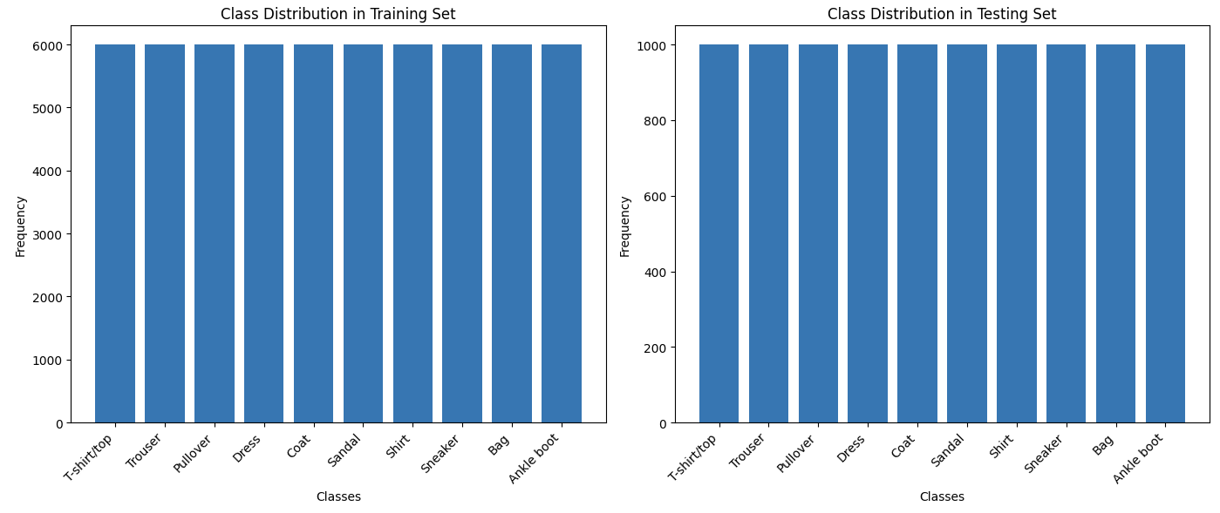
FASHION MINST
INTRODUCTION
DATASET DISTRIBUTION
WE USED A 80/20 TRAIN TEST SPLIT FOR THE DATASET. WE CAN ALSO SEE THE DISTRIBUTTION OF OUR DATASET IS EVENLY DISTRIBUTED ACROSS THE CLASSES IN THE TRAINING AND TESTING SET

Slide 6
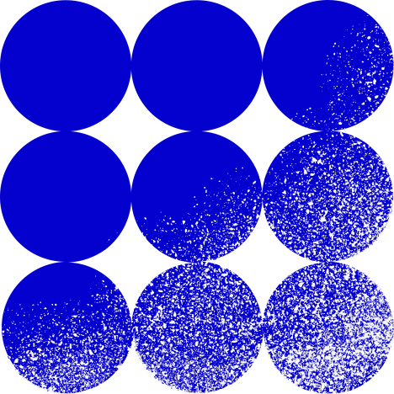
FASHION MINST
OUR MODELS
WE USED THE FOLLOWING MODLES AND MANAGED TO INCREASE THE MODELS ACCURACY WITH EACH APPROACH
DUMMY CLASSIFIER ~ 10% ACCURACY
AS EXPECTED THE MOST COMMON CLASS IS EQAUL IN OUR SENERIO (AS ALL CLASSES HAVE THE SAME AMOUNT OF IMAGES IN THE TEST AND TRIAN DATA SETS), HENCE WHEN WE PREDICT WE SHOULD RECIVE 10% ACCURACY. Let it be noted that any future model that dose not surpass this dummy classifier may be considered usless as this is our benchmark that one MUST pass in order to be considered usful.
PERCEPTRON ~ 80.83% ACCURACY
WE WANTED TO EXTEND THE PERCEPTRON BINARY CLASS FUNCTUNALITY TO A MULTICLASS PROBLEM LIKE OUR OWN, THIS IS DONE IIN THE SKLEARN LIBRARY BY IMPLEMENTING THE ONE-VS-REST (OVR) MULTICLASS STRATEGY. THE ONE-VS-REST STRATEGY ALLOWS PERCEPTRON TO TRAIN A SEPARATE MODEL FOR EACH CLASS COMPARING WITH ALL THE REMAINING CLASSES.THIS METHOD CREATES ONE PERCEPTRON MODEL FOR EACH CLASS AGAINST ALL OTHER CLASSES. IF THE TARGET VECTOR HAS FOUR CLASSES (E.G. HAT, PANTS, GLOVES, SOCKS), THIS STRATEGY WILL CREATE FOUR SEPARATE MODELS IN THE FOLLOWING WAY.
MODEL 1: HAT VS [PANTS, GLOVES, SOCKS]
MODEL 2: PANTS VS [HAT, GLOVES, SOCKS]
MODEL 3: GLOVES VS [PANTS, HAT, SOCKS]
MODEL 4: SOCKS VS [PANTS, GLOVES, HAT]
THIS WAY WE WERE ABLE TO USE PERCEPTRON WITH MULTIPLE CLASSES AND RECIVED AN ACCURACY OF ~80.83%

Slide 7
FASHION MINST
OUR MODELS
LOGISTIC REGRESSION ~ 85.10% ACCURACY
THE LOGISTICREGRESSION CLASS FROM SCIKIT-LEARN USES SOFTMAX REGRESSION FOR MULTICLASS CLASSIFICATION. THIS MEANS THAT THE INPUT FEATURES (E.G., A FLATTENED 28X28 IMAGE VECTOR) ARE PASSED THROUGH A MODEL THAT OUTPUTS PROBABILITIES FOR EACH CLASS.
This way we can use it to solve a multiclass classification problem and not only binary classification problem
KNN (ECLUIDIAN & MANHHATAN DISTANCES) ~ 85.47% , 86.26% ACCURACY
NEXT WE TRY THE EUCLIDEAN DISTANCE AND MANHATTAN DISTANCE (L1, L2) WITH OUR KNN CLASSIFIER AND RECIVE THE FOLOWING ACCURACEYS:
Euclidean distance: 85.47% .This metric calculates the straight-line distance between two points in Euclidean space.
Manhattan distance: 86.26% .This metric calculates the sum of absolute differences between the coordinates of the points.
THE DIFFERENCES IN ACCURACY CAN BE ATTRIBUTED TO HOW THESE DISTANCE METRICS MEASURE THE SIMILARITY BETWEEN DATA POINTS
SVM ~ 84.60% ACCURACY
THE TRAINING TIME OF THIS MODEL WAS REALLY LONG. HENCE LATER ON WE WILL SEE HOW WE OVER CAME THIS PROBELM

Slide 8
FASHION MINST
OUR MODELS
CNN ~ 84.98% ACCURACY
FINALLY, WE IMPLEMENTED OUR MOST COMPLEX MODEL, A CONVOLUTIONAL NEURAL NETWORK (CNN), AND ACHIEVED AN ACCURACY OF 85%.
CNNS ARE A TYPE OF DEEP LEARNING MODEL PARTICULARLY WELL-SUITED FOR IMAGE DATA AND OTHER SPATIALLY STRUCTURED DATA. THEY AUTOMATICALLY AND ADAPTIVELY LEARN SPATIAL HIERARCHIES OF FEATURES FROM INPUT IMAGES, WHICH MAKES THEM HIGHLY EFFECTIVE FOR IMAGE CLASSIFICATION TASKS. WE ASSUME THE MODEL DID NOT OUR PERFOURM THE OTHER MODELS BY A LAND SLIDE DUE TO THE DATAS RELITAVILY SMALL IMAGES.

Slide 9

FASHION MINST
PROBLEMS
SVM RUNTIME
THE TRAINING TIME FOR OUR SVM MODEL TOOK MUCH MUCH LONGER THAN OUR OTHER MODELS THIS IS DUE TO:
DIMENSIONALITY: THE COMPUTATIONAL COST INCREASES WITH THE NUMBER OF FEATURES. HIGH-DIMENSIONAL DATA MAKES THE OPTIMIZATION PROBLEM MORE COMPLEX AND COMPUTATIONALLY INTENSIVE.
COMPARED TO OUR OTHER MODELS:
K-NEAREST NEIGHBORS (KNN): KNN DOES NOT INVOLVE A TRAINING PHASE; IT SIMPLY STORES THE TRAINING DATA AND USES IT DURING PREDICTION. THUS, IT HAS NO TRAINING TIME, BUT IT CAN BE SLOW DURING PREDICTION.
LOGISTIC REGRESSION: LOGISTIC REGRESSION INVOLVES A SIMPLER OPTIMIZATION PROBLEM (USUALLY SOLVED USING GRADIENT DESCENT), MAKING IT FASTER TO TRAIN COMPARED TO SVMS.

Slide 10
FASHION MINST
SOLUTIONS
PCA
WE USED PCA AS A SOLUTION TO SPEED UP THE TRAINING PROCESS OF OUR SVM. BY REDUCING THE DIMENSIONALITY OF OUR DATASET.
WE SET OUR NUMBER OF DESIRED FEATURES TO 20
WITH FEWER FEATURES PCA TRANSFORMS THE ORIGINAL DATA INTO A NEW SET OF ORTHOGONAL COMPONENTS (PRINCIPAL COMPONENTS) THAT CAPTURE THE MAXIMUM VARIANCE. BY SELECTING THE TOP NNN PRINCIPAL COMPONENTS, WE REDUCED THE NUMBER OF FEATURES FROM 28X28 TO 20. THIS REDUCTION IN FEATURES SIMPLIFIES THE OPTIMIZATION PROBLEM, MAKING IT COMPUTATIONALLY LESS EXPENSIVE.
HENCE OUR RUNTIME WAS MUCH FASTER THIS TIME ROUND.
WE DECIDED TO RE-TRAIN ALL OUR SIMOLE MODELS ON THE 20 FEATURES USING PCA FOR FAIR RESULTS

Slide 11
FASHION MINST
OUR MODELS USING PCA
WE USED THE FOLLOWING MODLES AND MANAGED TO INCREASE THE MODELS ACCURACY WITH EACH APPROACH
PERCEPTRON ~ 71.45% ACCURACY
WE RECIVED SLIGHTLY LOWER ACCURACY WITH PCA BUT MANAGED TO MAINTAINE A DECENT RESULT WITH ONLY 20 FEATURES.
LOGISTIC REGRESSION ~ 80.09% ACCURACY
WE RECIVED SLIGHTLY LOWER ACCURACY WITH PCA BUT MANAGED TO MAINTAINE A DECENT RESULT WITH ONLY 20 FEATURES.
KNN (L2 DISTANCE) ~ 83.11% ACCURACY
WE RECIVED SLIGHTLY LOWER ACCURACY WITH PCA BUT MANAGED TO MAINTAINE A DECENT RESULT WITH ONLY 20 FEATURES.
SVM ~ 76.56% ACCURACY
WE RECIVED SLIGHTLY LOWER ACCURACY BUT MANAGED TO MAINTAINE A DECENT RESULT WITH ONLY 20 FEATURES.
Dimentions / Accuracy
Perceptron
Logistic regresion
KNN
SVM
WITH PCA ACCURACY
71.45%
80.09%
83.11%
76.56%
WITHOUT PCA ACCURCY
80.83%
85.10%
85.47%
84.60%

Slide 12
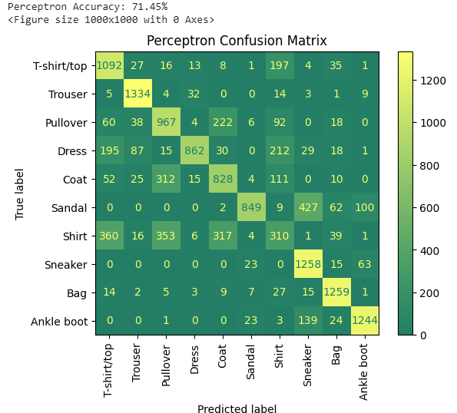
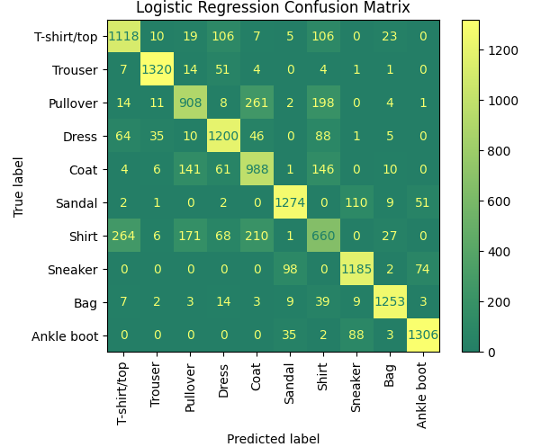

FASHION MINST
CONCLUSION
KEY FINDING AND INSIGHT.
NEXT WE LOOK INTO SOME OF OUR MODELS CONFUSION MATRIX’S AND MAKE SOME INSIGHTS INTO WHERE WHERE MODEL PERFOURMS WELL AND WHERE NOT
HERE WE CAN SEE THAT WHEN THE GROUND TRUTH LABEL IS A SNEAKER , ANKEL BOOT OR SANDAL THE MODEL RAERLY MISKTAKES IT FOR SOMTHING OTHER THAN THESE CLASSES. (BUT DOSE MIX UP BETWEEN THESE 3 CLASSES)
HERE WE CAN SEE WHEN THE GROUND TRUTH IS A SHIRT, THE MODEL OFFTEN GETS MIXED UP FOR T SHIRT, COAT AND PULL OVER
HERE WE CAN SEE WHEN THE GROUOND TRUTH IS TROUSERS (PANTS) THE MODEL MAINLY PREDICTS CORRECTLY WITH A SMALL NUMBER OF INSTANCES AS DRESSES

Slide 13
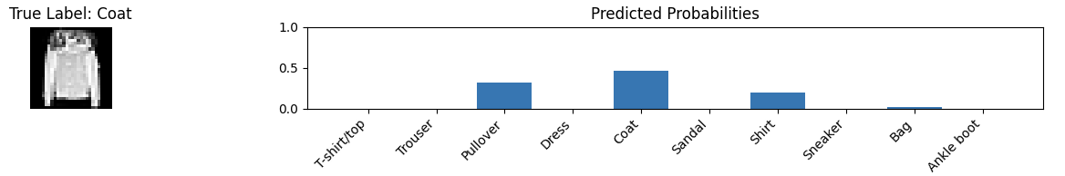
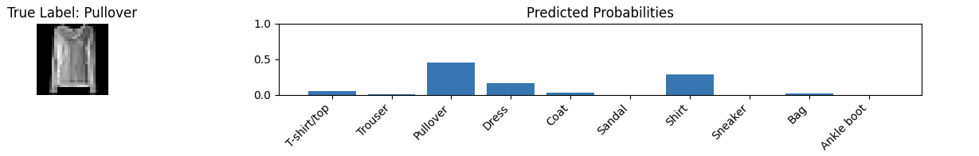
FASHION MINST
CONCLUSION
INTRESTING FINDINGS
WE CAN SEE HERE OUR CNN MODEL PREDICTS CORRECTLY ALTHOUGH OTHER CLASSES HAVE SIGNIFICAT PROBABILITYS

Slide 14
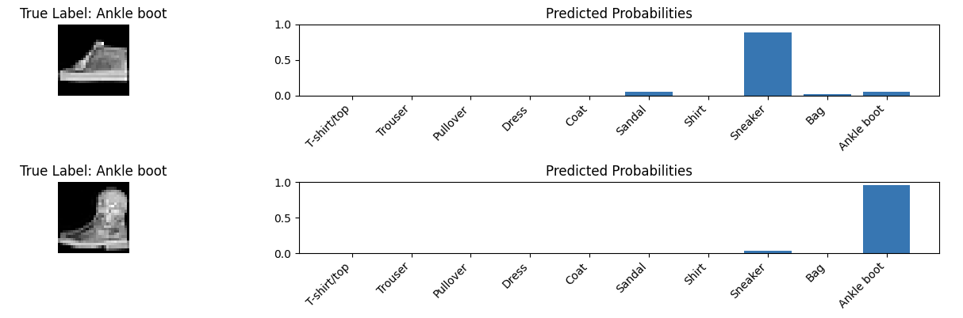

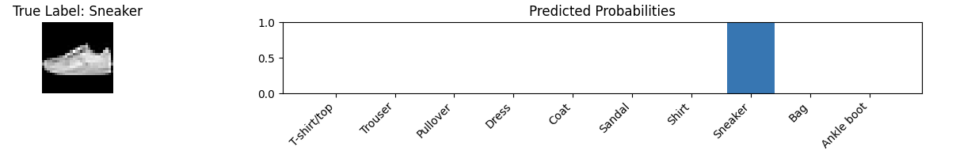
FASHION MINST
CONCLUSION
INTRESTING FINDINGS
WE CAN SEE THE MODEL MISCLASSIFIED THE ANKLE BOOT AS A SNEAKER. WE CAN EXPLAIN THIS BY LOOKING AT TWO IMAGES (CORRECTLY CLASSIFIED BY THE MODEL) AND SEE THAT INDEED THE MISCLASSIFIED IMAGE LOOKS MORE LIKE A SNEAKER THAN AN ANKEL BOOT AND THIS COULD EXPLAIN THE MISCLASSIFICATION

Slide 15
THANK YOU.
CODE GITHUB ATTACHMENT:
HTTPS://GITHUB.COM/JOSHUA-D-GORDON/MACHINE-LEARNING

